Slide 1
SMILE ON 60+
Let’s sink our teeth into this data!

Slide 2
SMILE ON 60+ Guide to Senior Oral Health Advocacy
SMILE ON 60+ is a statewide initiative with the goal of improving the overall health of low income, mobile seniors age 60+ through access to oral healthcare services and community education.
Tennessee is ranked 49th for senior dental care.
Dental care is an important component of overall health for the older population.
Diabetes and bleeding gums increases your risk of premature death by 400-700%. (American Academy for Oral Systemic Health)

Slide 3
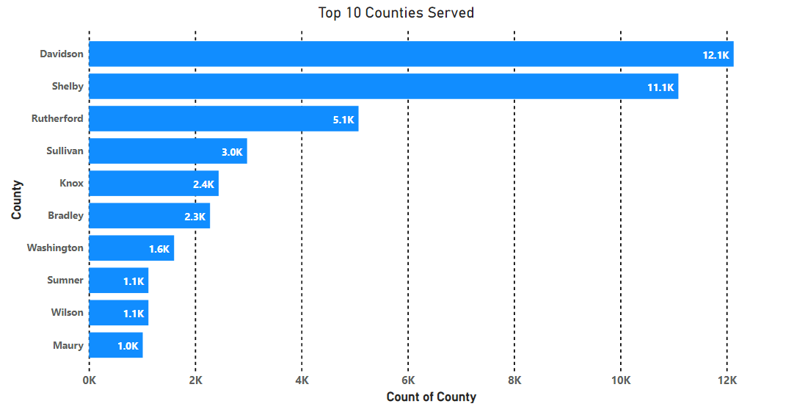
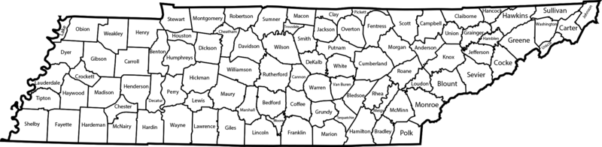
Davidson and Shelby represent the 2 most populous counties in the State of Tennessee
Knox County is third but has significantly fewer people taking advantage of Smile On’s program

Slide 4
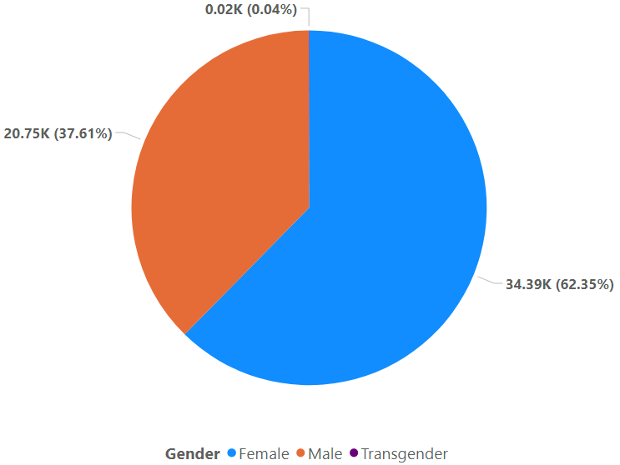
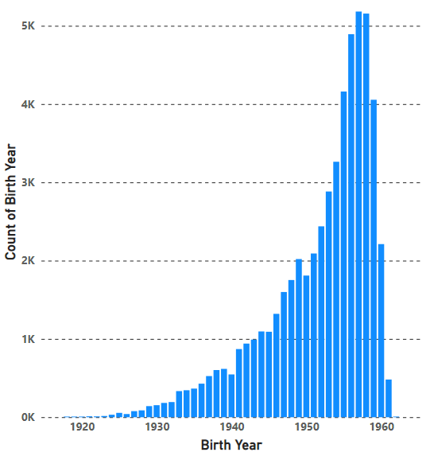
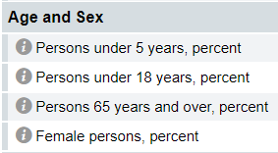
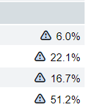
: Tennessee

Slide 5
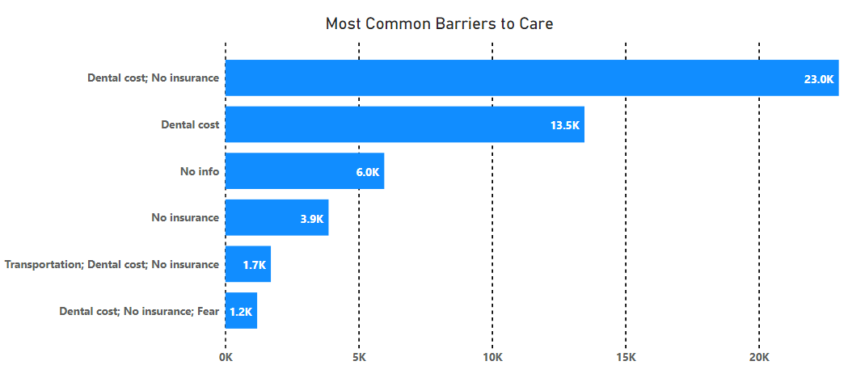

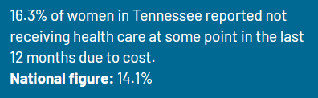
The largest percentage of Smile On patients (76.4%) fall into the lowest income bracket, $0 - $21,280
The intersection between income and gender tracks with statistics pulled from NWLC.org

Slide 6
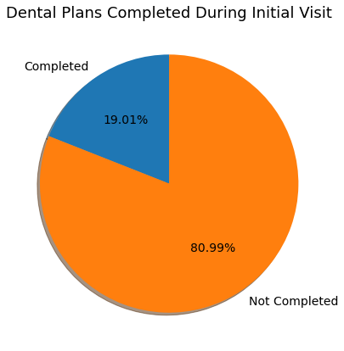
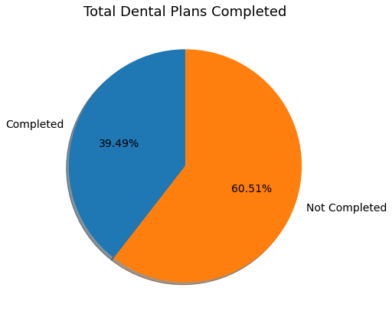
Progress of Completed Dental Plans
Of 10,711 registered patients, 7,098 had at least one office visit.
1,349 completed dental plans on first visit, roughly 19% of those who came in for dental care.
Over time, an additional 2,467 plans were completed, bringing the total to nearly 40%.

Slide 7
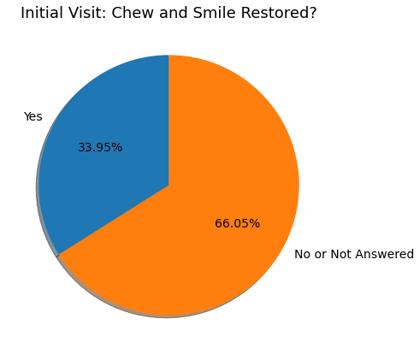
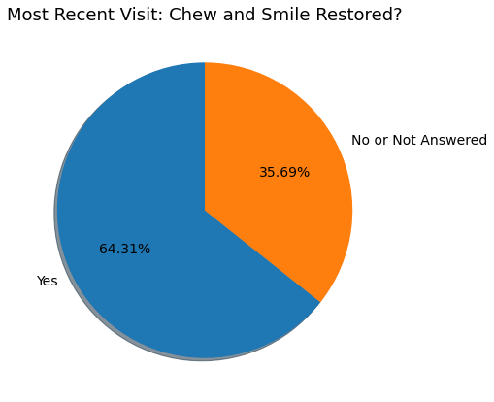
Progress of Restored Chew and Smile
Of 10,711 registered patients, 7,098 had at least one office visit.
Of these, 2,410 had chewing and social 6 (smile) restored during initial visit, representing 34%.
Over time, an additional 1560 patients were restored, up 30%, bringing the total to roughly 64%.

Slide 8
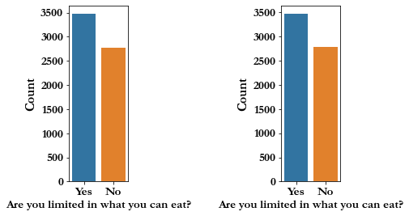
Example of Similar Data
Start of program
After last visit

Slide 9
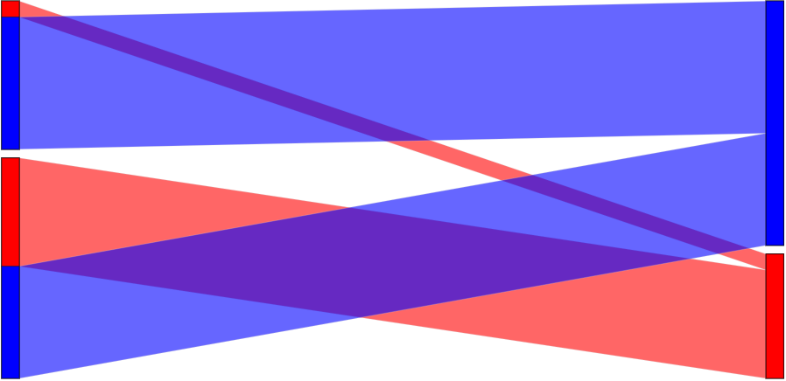
Client Outcomes
Start of program
After last visit
2410
patients
with
healthy
teeth
3970
patients
with
healthy
teeth
3579
patients
with
unhealthy
teeth
2019
patients
with
unhealthy
teeth

Slide 10
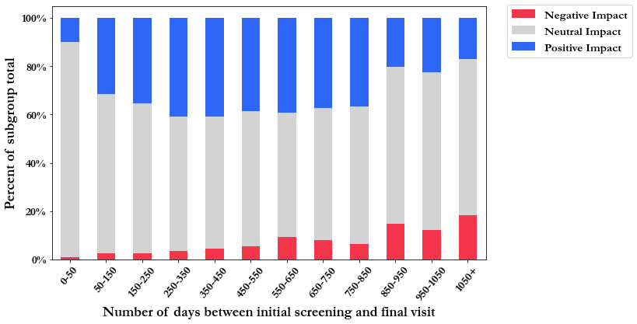
Client Outcomes Over Time

Slide 11
Moving Forward
Increase outreach to underserved areas: Knox county and beyond
Intervene as quickly as possible to increase likelihood of positive outcomes
Implement and follow through on Treatment Plans as often as possible
Revisit forms and eliminate unnecessary questions
Streamline data entry

